Slide 1
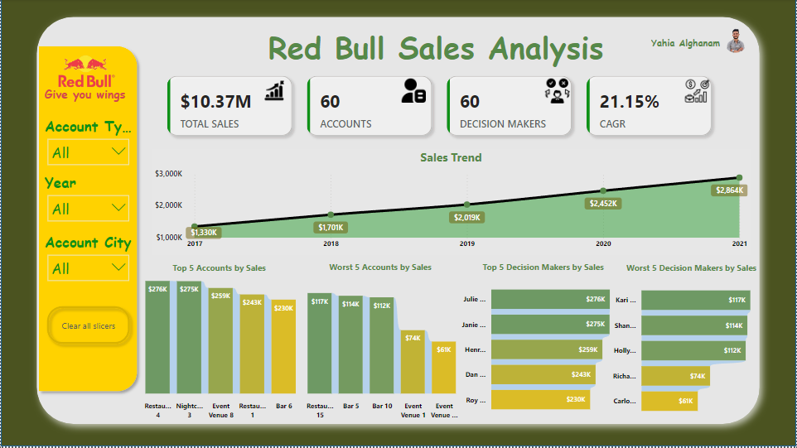
Data Analysis: Red Bull Accounts Sales

Slide 2
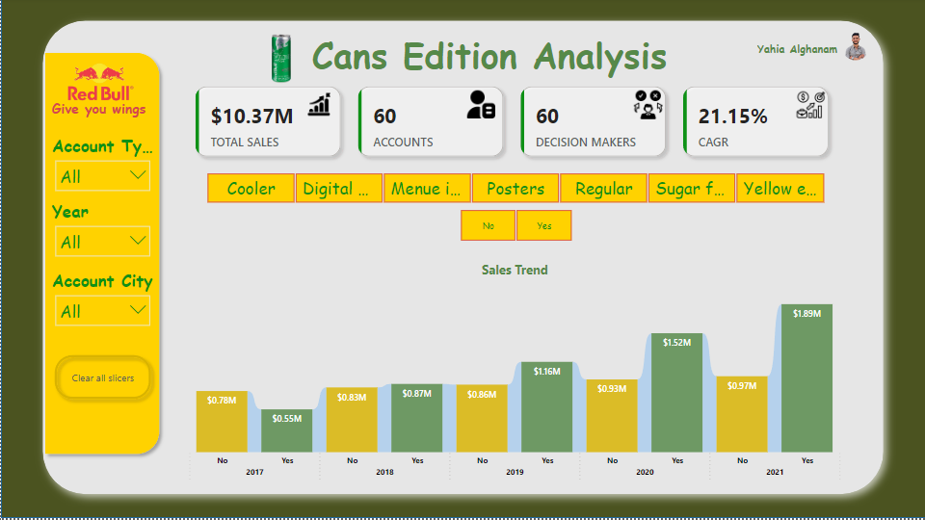
Data Analysis: Red Bull Cans Edition Sales

Slide 3

1. Total Sales Overview
Total Sales 10.37 M
Accounts 60
Decision makers 60
CAGR 21.15 %

Slide 4
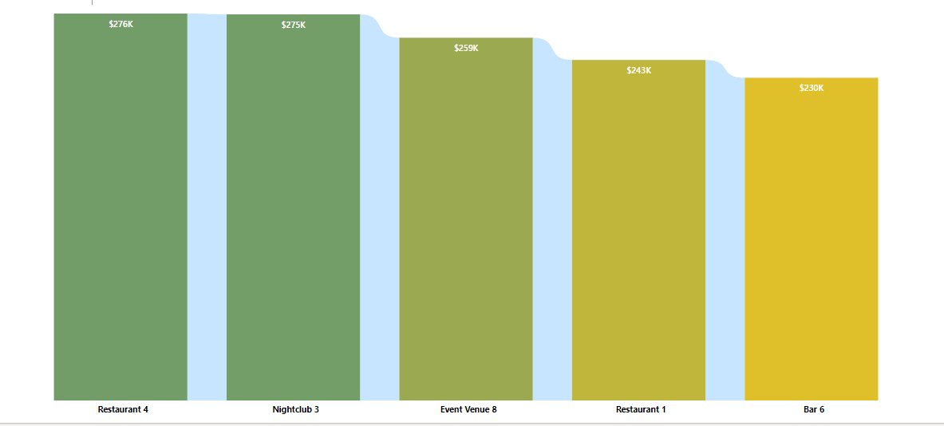
2. Top 5 Accounts by Sales
Best Performing Accounts
Resturant 4 276K $
Nightclub 3 275K $
Event Venue 8 259K $
Restaurant 1 243K $
Bar 6 230K $
These accounts are key contributors to the overall sales. Restaurants and bars appear to be strong categories, showing that Red Bull is popular in these venues.

Slide 5
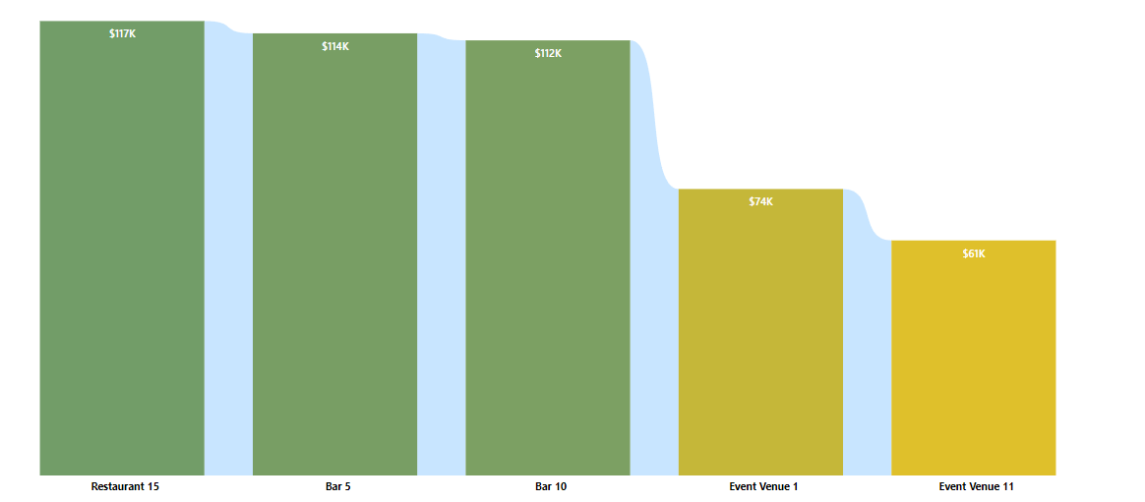
3. Worst 5 Accounts by Sales
Worst Performing Accounts
Event Venue 4 61K $
Event Venue 1 74K $
Bar 10 112K $
Bar 5 114K $
Restaurant 15 117K $
This data shows that some venues, especially certain event venues, may not be performing as expected. This could be due to low attendance or lower demand for energy drinks in these locations.

Slide 6
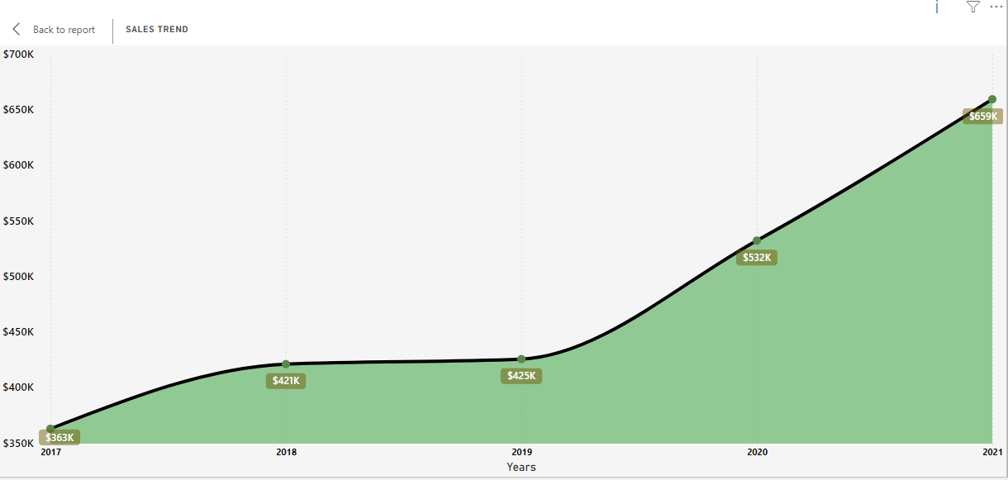
4. Sales Trend for Bars
The sales trend for bars shows growth of sales over the years, with a notable increase in 2021. Despite the slightly decrease in 2018, but recovered again during 2019.
the overall trend indicates growth potential in this account type, especially in last 2years.

Slide 7
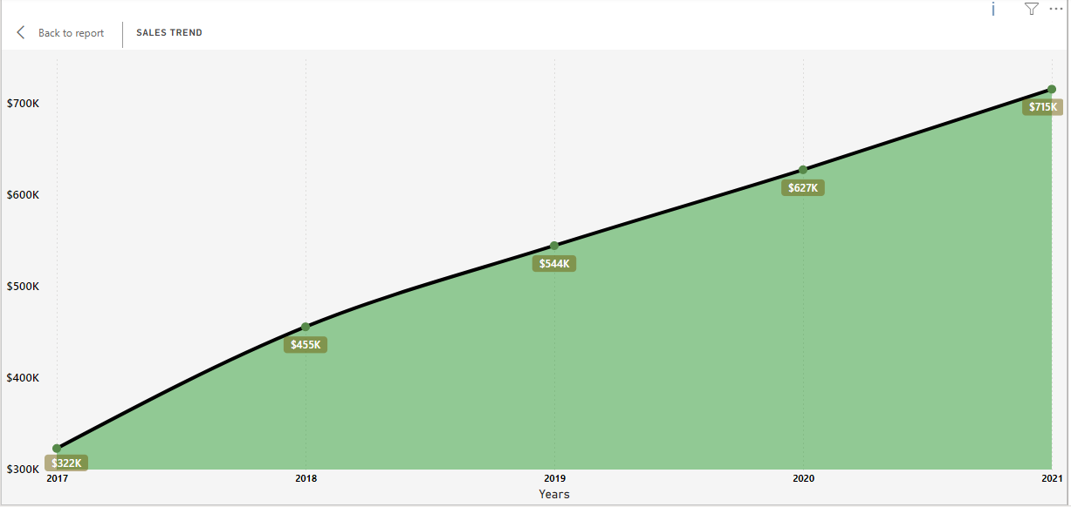
4. Sales Trend for Restaurants
Restaurant sales experienced a steady rise from 2017 to 2021. Starting at $322K in 2017, sales increased to $455K in 2018 and $544K in 2019. The growth persisted with $627K in 2020, and the highest sales were recorded in 2021 at $715K. This consistent increase suggests successful menu offerings and high customer satisfaction.

Slide 8
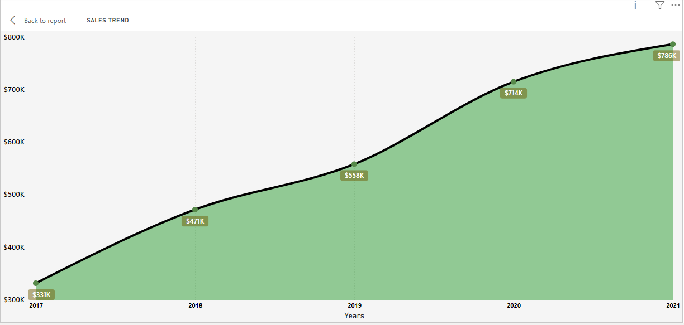
4. Sales Trend for Clubs
Club sales showed continuous growth over the five-year period. In 2017, sales were $331K, which increased to $471K in 2018. The upward trend continued with $558K in 2019 and $714K in 2020. By 2021, sales had peaked at $786K, indicating strong market presence and effective customer engagement strategies.

Slide 9
4. Sales Trend for Hotels
Hotel sales demonstrated a consistent upward trend from 2017 to 2021. Starting at $314K in 2017, sales increased steadily each year, reaching $354K in 2018 and $492K in 2019. The growth continued in 2020 with sales at $578K, and the highest sales were recorded in 2021 at $704K. This steady increase suggests successful marketing strategies and growing customer loyalty.

Slide 10
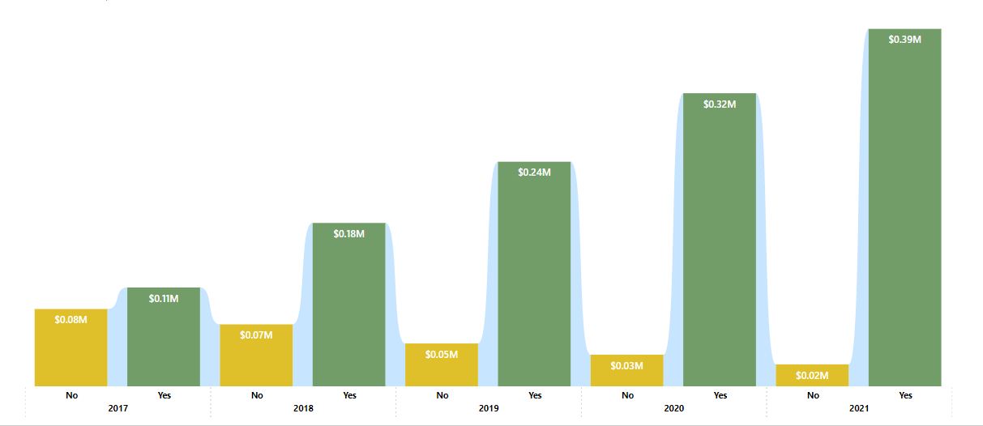
4. Sugar Free Edition Sales Analysis
Sales for the sugar-free edition varied significantly over the years. In 2017, sales were $0.07M for the "No" category and $0.11M for the "Yes" category. The highest sales were recorded in 2018, with $0.18M for "No" and $0.39M for "Yes." However, there was a sharp decline in 2020 and 2021, with sales dropping to $0.05M and $0.02M for "No," and $0.03M and $0.08M for "Yes," respectively. This decline could be due to market saturation or changing consumer preferences.

Slide 11
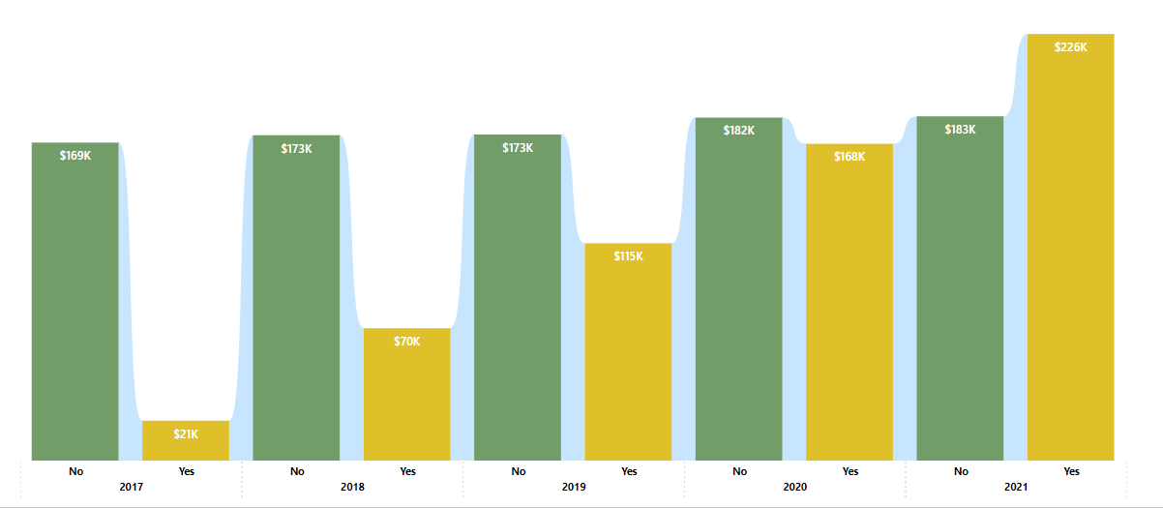
4. Cooler Edition Sales Analysis
Cooler edition sales generally increased from 2017 to 2021. In 2017, sales were $21K for the "No" category and $169K for the "Yes" category. Sales remained stable in 2018 and 2019, with slight increases each year. The highest sales were recorded in 2021, with $159K for "No" and $226K for "Yes." This trend suggests a growing preference for cooler editions among consumers.

Slide 12
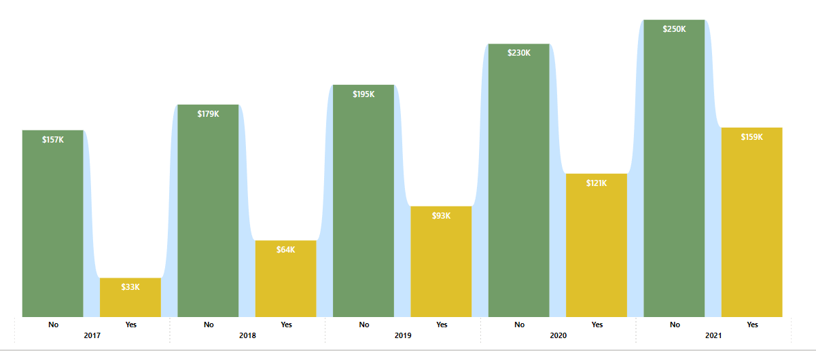
4. Digital Screen Edition Sales Analysis
Sales for the digital screen edition showed steady growth over the five years. In 2017, sales were $33K for the "No" category and $179K for the "Yes" category. The upward trend continued, with sales peaking in 2021 at $183K for "No" and $250K for "Yes." This consistent increase indicates a strong market presence and high demand for digital screen editions.

Slide 13
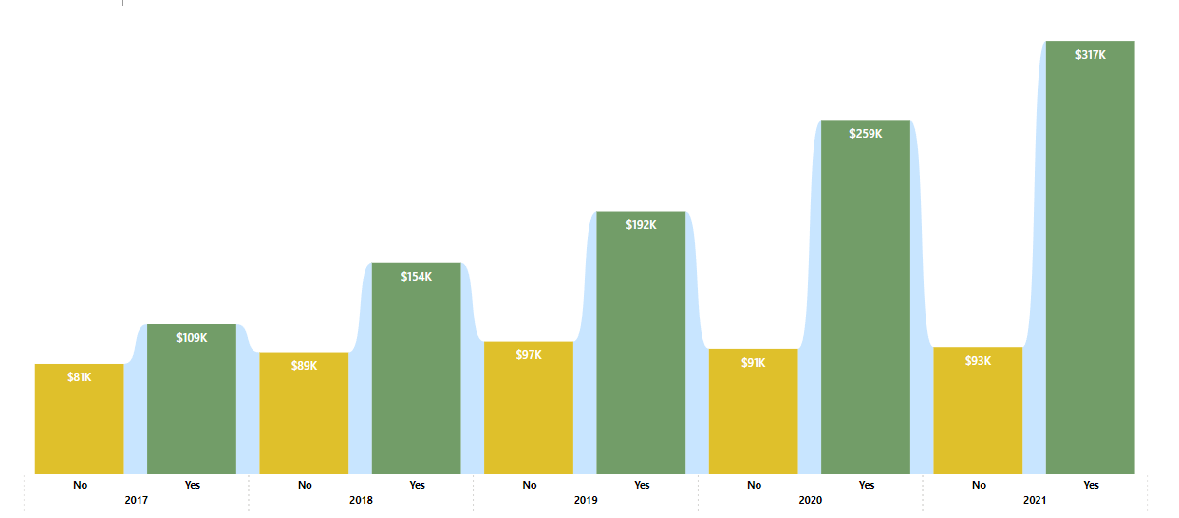
Menu Include Edition Sales Analysis
The menu include edition sales increased significantly from 2017 to 2021. Starting at $81K for "No" and $109K for "Yes" in 2017, sales saw a steady rise each year. The highest sales were recorded in 2021, with $93K for "No" and $277K for "Yes." This growth suggests successful marketing and high consumer interest in menu include editions.

Slide 14
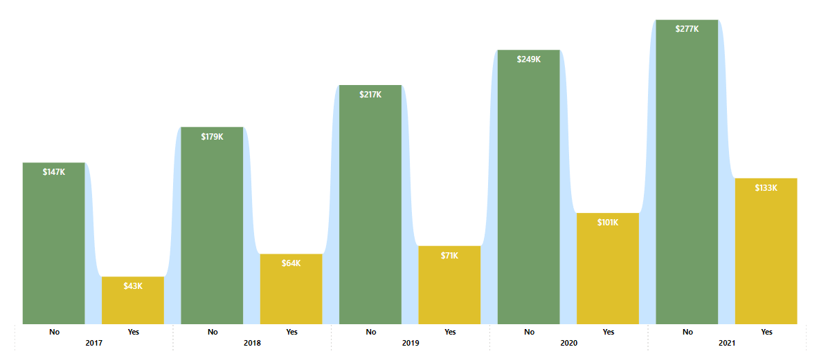
Posters Edition Sales Analysis
Poster edition sales showed a steady increase over the five-year period. In 2017, sales were $43K for "No" and $147K for "Yes." The upward trend continued, with the highest sales recorded in 2021 at $133K for "No" and $317K for "Yes." This consistent growth indicates strong market demand and effective promotional strategies.

Slide 15
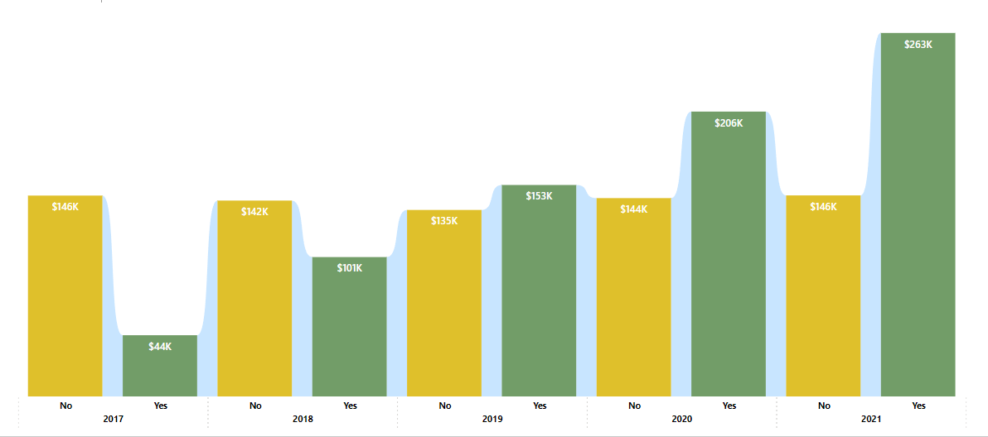
Yellow Edition Sales Analysis
Yellow edition sales fluctuated but generally increased from 2017 to 2021. In 2017, sales were $44K for "No" and $263K for "Yes." Sales peaked in 2021 at $146K for "No" and $277K for "Yes." Despite some fluctuations, the overall trend suggests a strong market presence and consumer interest in yellow editions

Slide 16
Observations and Key Takeaways
Growth Potential: The steady increase in sales, especially with a CAGR of 21.15%, indicates that Red Bull has strong market penetration and potential for continued growth.
High and Low Performers: While there are a few top-performing decision-makers and accounts, focusing on the worst performers presents an opportunity for growth or corrective action.
Impact of External Events: The drop in 2019 sales suggests external factors, such as the pandemic, had a notable impact, but the company was able to recover well in 2020 and 2021.
Product Variety: The Cans Edition Analysis shows that there is demand for various product editions, and this diversity in offerings helps maintain a steady revenue stream.

